Slide 1

PYTHON
First Steps With Python

Slide 2
Install Python in Windows

Slide 3
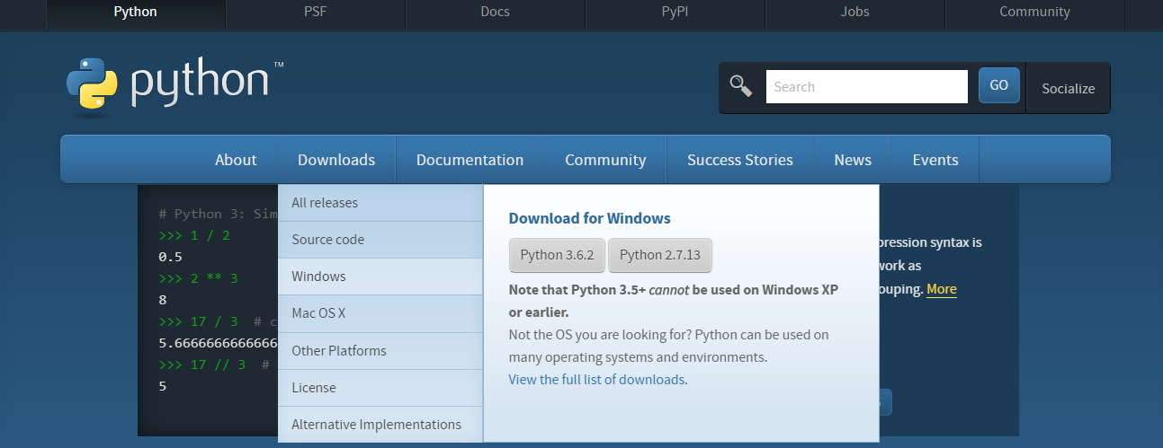
Install Python in Windows Environment
1. To install Python, firstly download the Python distribution from www.python.org/download.

Slide 4
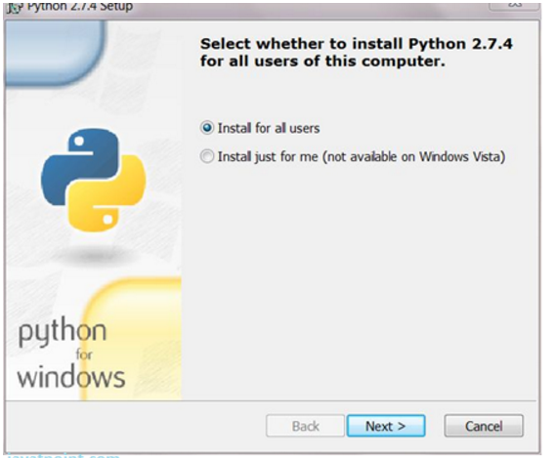
2.Having downloaded the Python distribution now execute it. Double click on the downloaded software. Follow the steps for installation

Slide 5
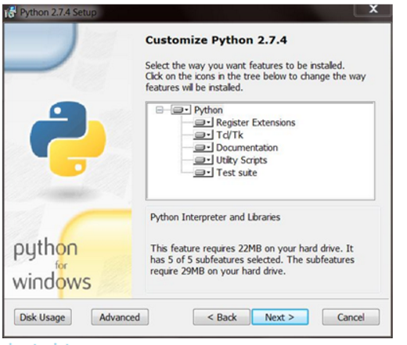
3) You will see a dialog window, click “Next” button.

Slide 6
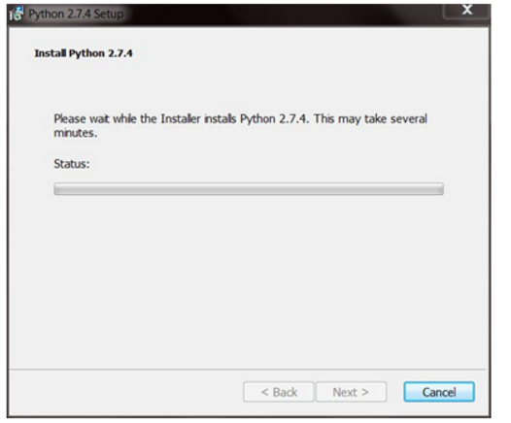
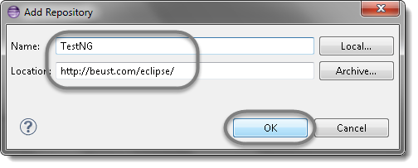
4) Installation take some times

Slide 7
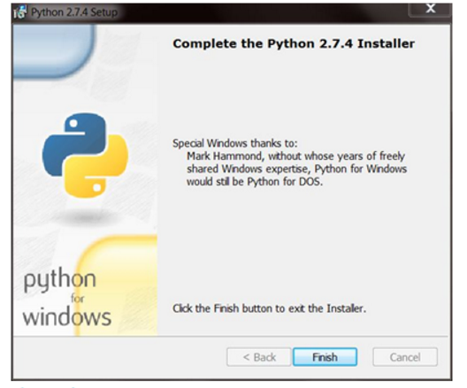
5) Complete the Python Installer just press “Finish” button.

Slide 8
Your questions are welcome!

Slide 9
THANK YOU

